Slide 1
BITC & Business Connectors
Steve Mitchell
Business Connector – Gloucester & Cheltenham

Slide 2
Agenda
* Who is Business in the Community?
* What are Business Connectors?
* The value of Connectors in the Community
* Local Case Studies
* Supporting the CCG’s Sustainability & Transformation Plan
* Get involved – The BIG Community Conversation
* Q&A

Slide 3
Who is Business in the Community?
A business-led charity with a unique ability to convene the most senior business leaders from UK and global companies
Business in the Community is the Prince's Responsible Business Network. Our members work together to tackle a wide range of issues that are essential to creating a fairer society and a more sustainable future
We are a business-led charity with more than 30 years' experience of mobilising business. We engage thousands of businesses through our programmes driven through a core membership of more than 800 organisations from small enterprises to global corporations
We work locally, nationally and internationally through a network of partners world-wide
HRH The Prince of Wales is our President

Slide 4
What are Business Connectors?
A Business Connector identifies local needs and helps to create cross-sector partnerships
Business Connectors are talented individuals seconded from business and the Civil Service, trained by Business in the Community and placed in local communities of greatest need
The nature of the programme’s commitment is unprecedented, delivering more than 230 senior secondees
Collectively Business Connectors are changing the culture of how business, the public sector and communities collaborate for the benefit of these sectors and the wider society

Slide 5
The value of Connectors in the Community
Together, Businesses Connectors across the country have made more than 3,500 connections which have resulted in 9,360 instances of support being received by organisations working to benefit their communities
Since the programme began, millions of pounds have been leveraged in support of local communities and this continues to increase all the time
The Business Connector programme increases the positive impact of business in local communities by harnessing the expertise and energy of business people to tackle local challenges
The Business Connector model of long term business secondments is creating deeper and more effective relationships between business and communities. The knowledge, skills and relationships Business Connectors take back into their seconding company is also creating a shift in the culture of how business interacts with the community
To date we have recruited 243 Business Connectors who have worked in 124 locations

Slide 6
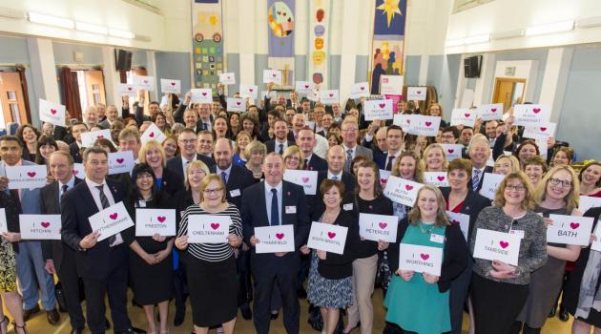
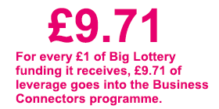
Put another way…
Pounds & Pence

Slide 7





Case Studies: Gloucester Bike Project & Nelson Trust

Slide 8
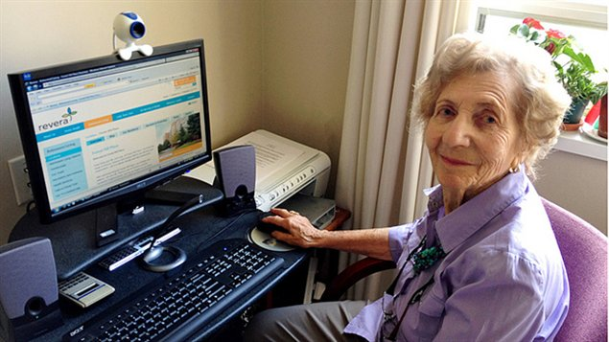
Supporting the CCG’s Sustainability & Transformation Plan
Business Connectors offer a range of practical ways for businesses to work together and take action to help tackle some of the key issues facing society;
Education
Employment
Enterprise
Social Cohesion
Social Isolation

Slide 9
Get involved: The BIG Community Conversation
The Lakeside Suite – Bowden Hall Hotel
Thursday 27th April
9.30-13.00
56 Senior Leaders from multiple sectors – Business, Charity, Health, Education & Local Government
Book your place at www.eventbrite.co.uk/TheBIGCommunityConversation

Slide 10
Any questions?

Slide 11

Time for a short video?

